Slide 1
Deep Learning for Leaf Disease Detection using CNN
Mentor: R. Goutham
K LAKSHMI SAI SURYA KAUSHIK(1602-17-735-078)
B RAVI KISHORE REDDY(1602-17-735-092)
VIDYA SAGAR(1602-17-735-116)
Batch No.7

Slide 2
AIM and Specifications
Objective: To design a system for detection of crop diseases & to alert the farmers at the right time before the disease spreads over large area
Introduction: Farmers are unaware of non-native diseases. Consultation of experts for this might be time consuming & costly. Also unnecessary use of pesticides might be dangerous. We can minimize farmers effort and help him get high quality and more quantity yield by making use of Machine Learning.
Specification: There are two main characteristics of plant disease detection machine-learning methods that must be achieved, they are: speed and accuracy.
There is need for developing technique such as automatic plant disease detection and classification using leaf image processing techniques

Slide 3
Abstract
Viral diseases are major sources of poor yields. With the help of data science, it may be possible to identify common diseases so they can be treated.
Existing methods of disease detection require farmers to solicit the help of government-funded agricultural experts to visually inspect and diagnose the plants. This suffers from being labour-intensive, low-supply and costly. As an added challenge, effective solutions for farmers must perform well under significant constraints, since farmers may only have access to mobile-quality cameras with low-bandwidth
This project presents a way to detect various leaf diseases and to classify/segregate them. To achieve this we are using Keras and Convolutional Neural Networks to classify the leaf diseases.
Keywords: Convolutional Neural Networks, Deep Learning, Classification, Keras.

Slide 4
LITERATURE SURVEY
G. Madhulatha and O. Ramadevi, "Recognition of Plant Diseases using Convolutional Neural Network," 2020
Plant Diseases recognition on images using Convolutional Neural Networks: A Systematic Review
A. Abade, Paulo Ferreira, F. Vidal, 2020
Plant Disease Classification: A Comparative Evaluation of Convolutional Neural Networks and Deep Learning Optimizers
M. Saleem, J. Potgieter, K. Arif, 2020
Big Data and Deep Learning in Plant Leaf Diseases Classification for Agriculture
Mohamed Loey, 2021
Convolutional Neural Networks for the Automatic Identification of Plant Diseases
J. Boulent, Pierre-Luc St-Charles, 2019
M. A. Jasim and J. M. AL-Tuwaijari, "Plant Leaf Diseases Detection and Classification Using Image Processing and Deep Learning Techniques," 2020

Slide 5
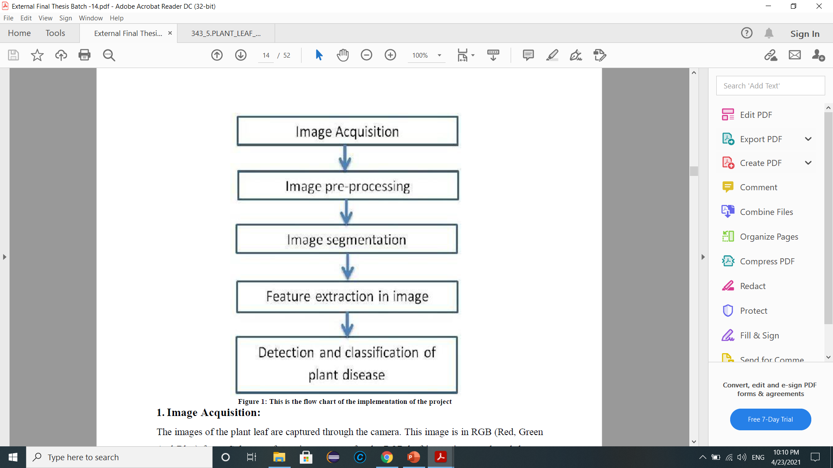
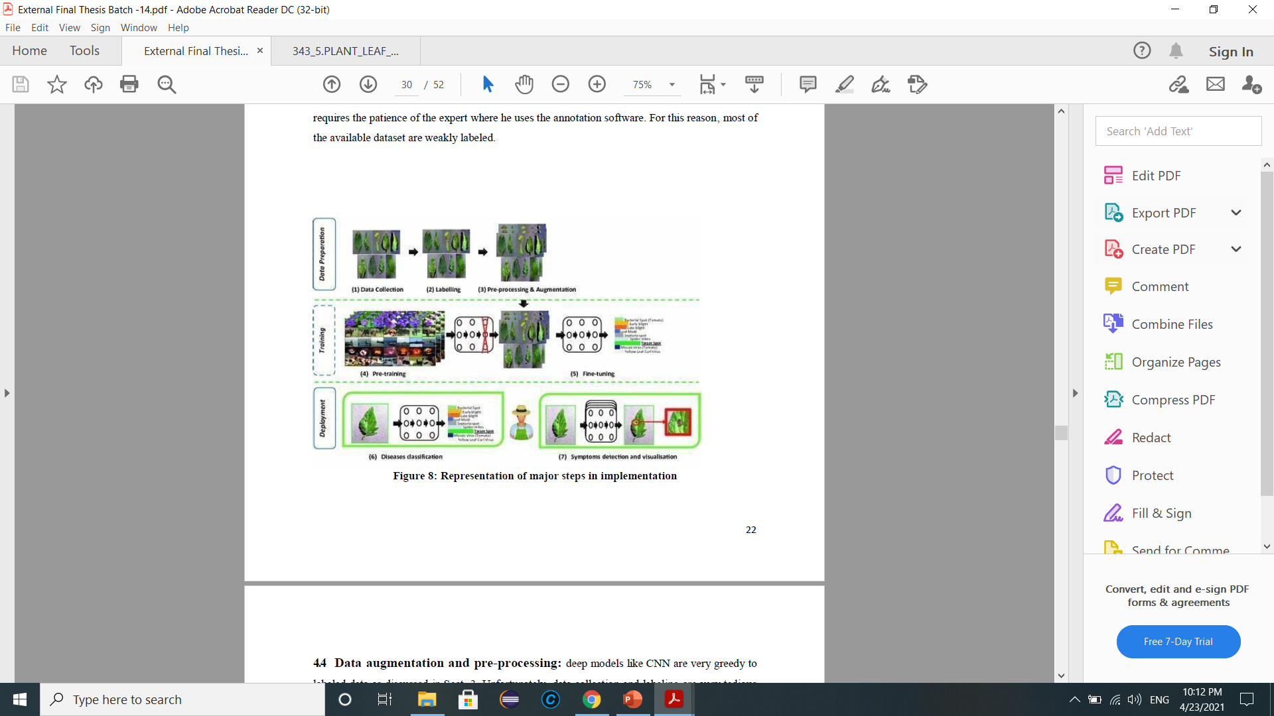
Working:

Slide 6
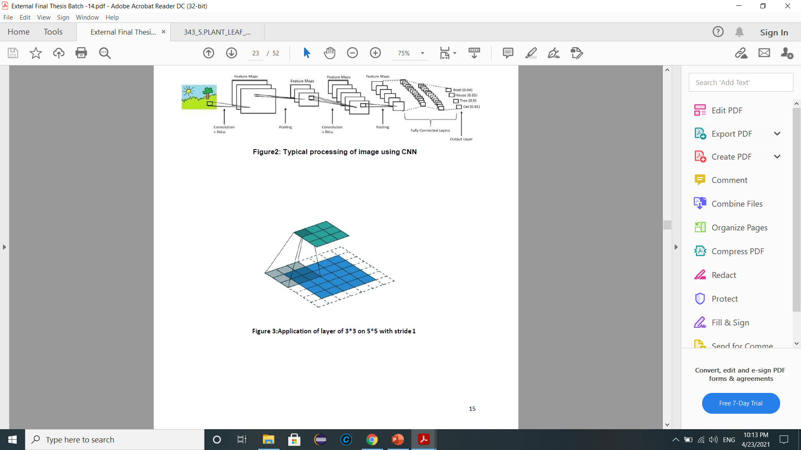
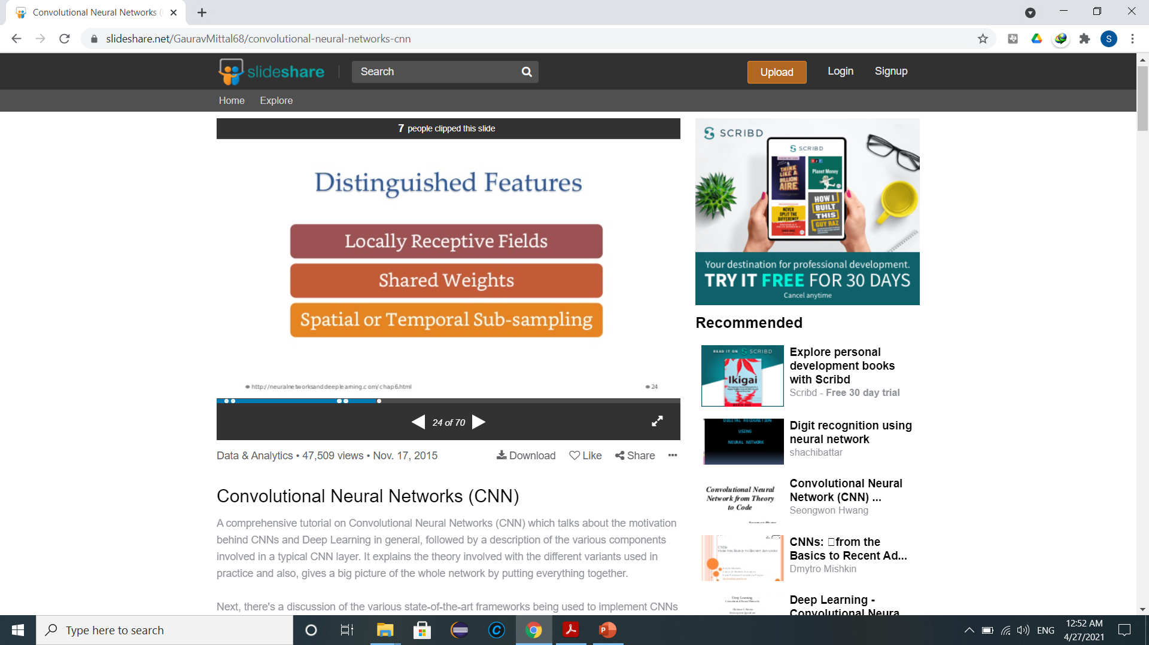
PROPOSED SOLUTION
CNNs are regularized versions of multilayer perceptron’s. Multilayer perceptron’s usually mean fully connected networks. Accuracy is around 96%(Based on previous studies).
No need to hard-tune the features
It is a feature learner
To learn non-linear functions, we use linear combination and composition
Distinguished features:

Slide 7
SOFTWARE REQUIREMENTS FOR BUILDING MODEL
Python 3.9 and its libraries
1.NumPy(To do multi-dimensional array computations) and Pandas(high-level data manipulation tool)→internal dependencies for other libraries
2., ScikitLearn(Has classification, regression and clustering algorithms
Keras Library (Provides API and has implementations of neural-network building blocks such as layers, objectives, activation functions, optimizers. Also it can run on top of TensorFlow.)
TensorFlow (Platform to Build and train models by using the high-level Keras API )
OpenCV Library (Used to develop Computer Vision applications. Provides image processing, video capture and analysis.)
Pickle library to bundle the models and save them

Slide 8
SOFTWARE REQUIREMENTS FOR BUILDING GUI
Python 3.9 and its libraries
1.NumPy(To do multi-dimensional array computations) and Pandas(high-level data manipulation tool)→internal dependencies for other libraries
2. Flask (As a Backend, gives REST API endpoints) and HTML,CSS,JS for FrontEnd
Keras Library (Provides API and has implementations of neural-network building blocks such as layers, objectives, activation functions, optimizers. Also it can run on top of TensorFlow.)
Sci-kit learn and Pickle library to bundle the models and save them
TensorFlow (Platform to Build and train models by using the high-level Keras API )
OpenCV Library (Used to develop Computer Vision applications. Provides image processing, video capture and analysis.)
PlantVillage Dataset

Slide 9
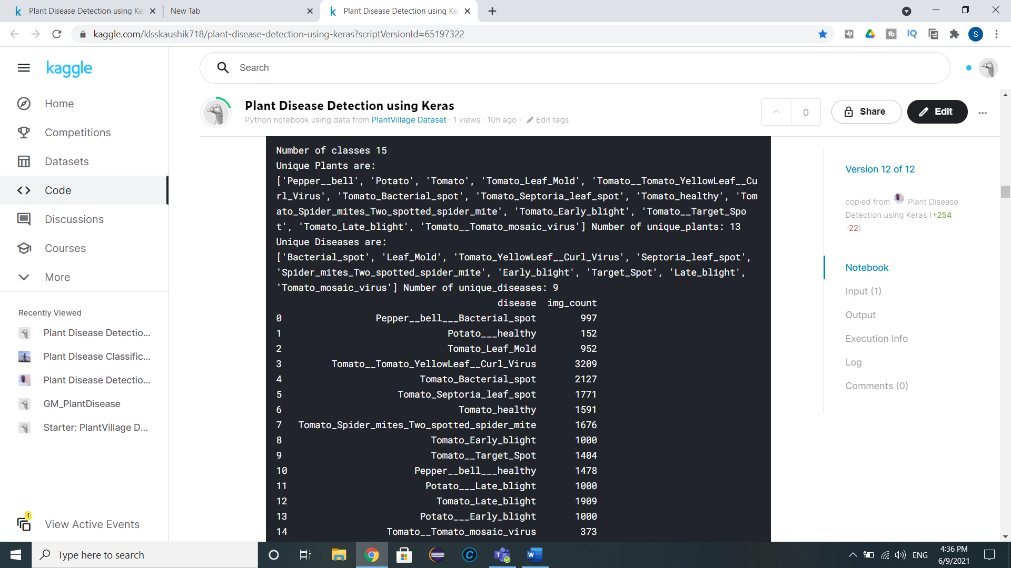

Slide 10
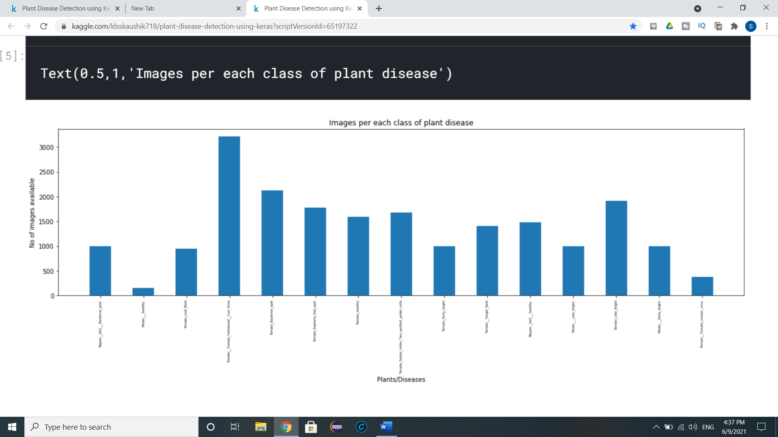
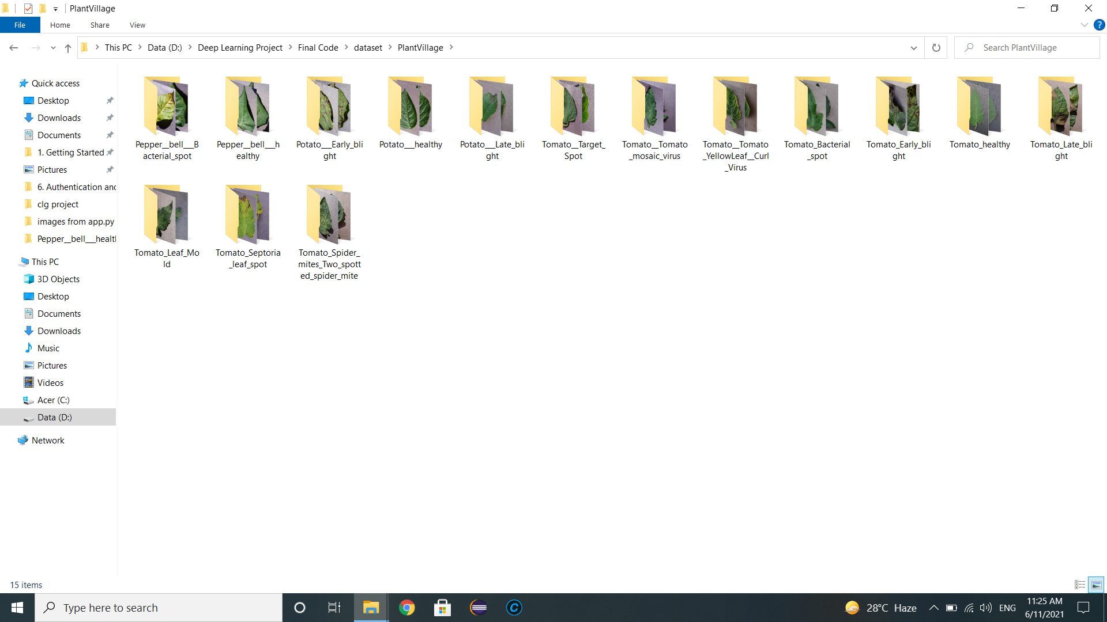

Slide 11
CODE TO BUILD MODEL
Trained the model based on data(strongly labelled images) collected from Plant Village Dataset In Kaggle.
//after image preprocessing
label_binarizer = LabelBinarizer()
image_labels = label_binarizer.fit_transform(label_list)
pickle.dump(label_binarizer,open('label_transform.pkl', 'wb'))
n_classes = len(label_binarizer.classes_)
//split dataset
x_train, x_test, y_train, y_test = train_test_split(np_image_list, image_labels, test_size=0.2, random_state = 42)
aug = ImageDataGenerator(
rotation_range=25, width_shift_range=0.1,
height_shift_range=0.1, shear_range=0.2,
zoom_range=0.2,horizontal_flip=True,
fill_mode="nearest")

Slide 12
model = Sequential(); inputShape = (height, width, depth)
model.add(Conv2D(32, (3, 3), padding="same",input_shape=inputShape))
model.add(Activation("relu"))
model.add(BatchNormalization(axis=chanDim))
model.add(MaxPooling2D(pool_size=(3, 3)))
model.add(Dropout(0.25))
model.add(Conv2D(64, (3, 3), padding="same"))
model.add(Activation("relu"))
model.add(BatchNormalization(axis=chanDim))
model.add(Conv2D(64, (3, 3), padding="same"))
model.add(Activation("relu"))
model.add(BatchNormalization(axis=chanDim))
model.add(MaxPooling2D(pool_size=(2, 2)))
model.add(Dropout(0.25))
model.add(Conv2D(128, (3, 3), padding="same"))
model.add(Activation("relu"))
model.add(BatchNormalization(axis=chanDim))
model.add(Conv2D(128, (3, 3), padding="same"))
model.add(Activation("relu"))
model.add(BatchNormalization(axis=chanDim))
model.add(MaxPooling2D(pool_size=(2, 2)))
model.add(Dropout(0.25))
model.add(Flatten())
model.add(Dense(1024))
model.add(Activation("relu"))
model.add(BatchNormalization())
model.add(Dropout(0.5))
model.add(Dense(n_classes))
model.add(Activation("softmax"))

Slide 13
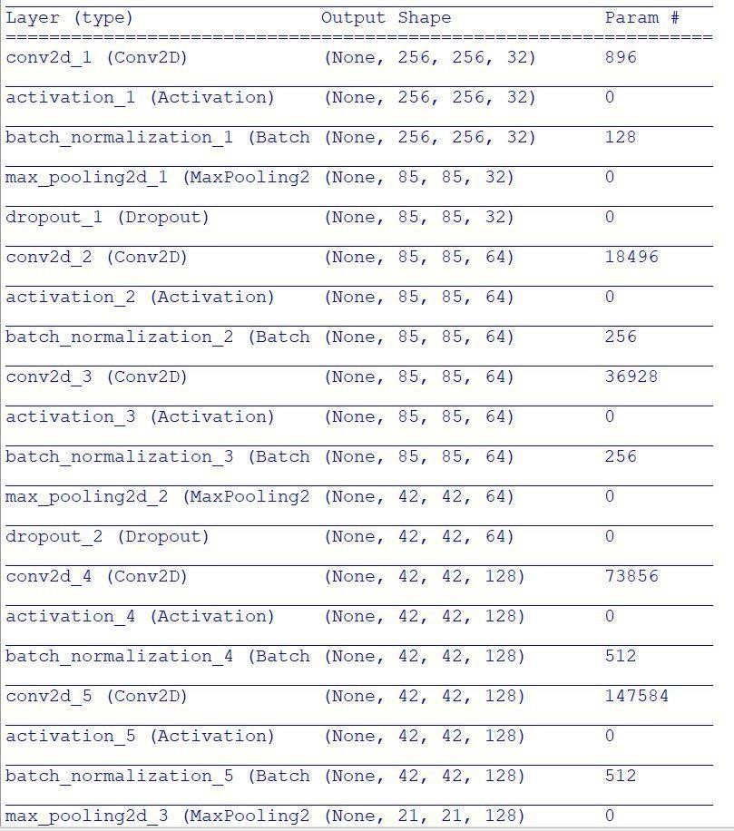
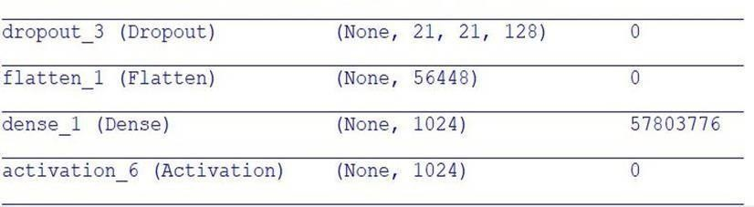

Slide 14
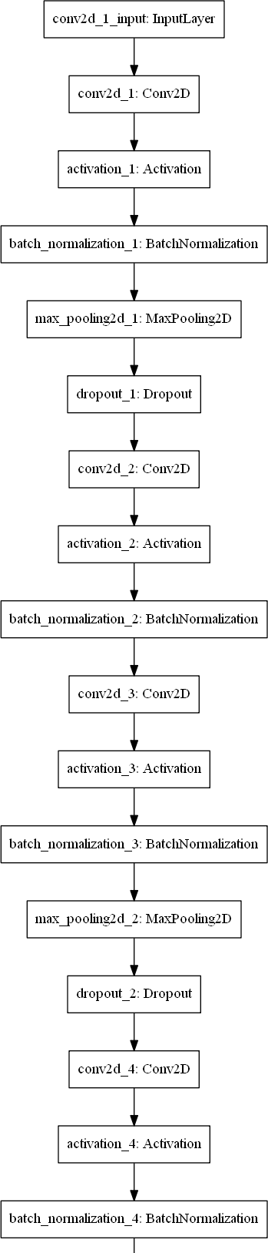
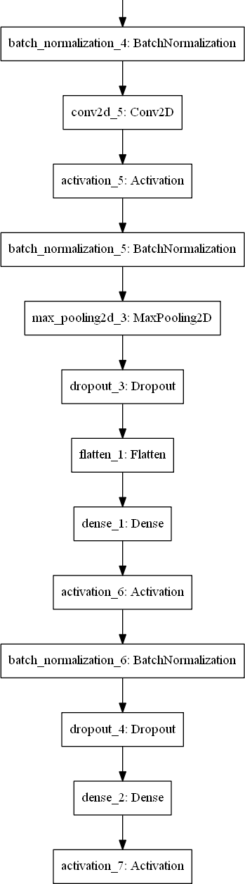

Slide 15
GUI CODE
@app.route('/', methods=['GET'])
def index():
# Main page
return render_template('index.html')
@app.route('/predict', methods=['GET', 'POST'])
def upload():
if request.method == 'POST':
# Get the file from post request
f = request.files['file']
# Save the file to ./uploads
basepath = os.path.dirname(__file__)
file_path = os.path.join(
basepath, 'uploads', secure_filename(f.filename))
f.save(file_path)
filename = 'cnn_model.pkl'
model = pickle.load(open(filename, 'rb'))
filename = 'label_transform.pkl'
image_labels = pickle.load(open(filename, 'rb'))
return predict_disease(file_path,model,image_labels)
return None
if __name__ == '__main__':
app.run(port=5000, debug=True)
def convert_image_to_array(image_dir):
try:
image = cv2.imread(image_dir)
if image is not None:
image = cv2.resize(image, DEFAULT_IMAGE_SIZE)
return img_to_array(image)
else:
return np.array([])
except Exception as e:
print(f"Error : {e}")
return None
def predict_disease(image_path,model,image_labels):
image_array = convert_image_to_array(image_path)
np_image = np.array(image_array, dtype=np.float16) / 225.0
np_image = np.expand_dims(np_image,0)
plt.imshow(plt.imread(image_path))
print("kk6")
result = model.predict_classes(np_image)
print((image_labels.classes_[result][0]))
print("Probability of Prediction:"+str(np.max(result)))
print("kk7")
return (image_labels.classes_[result][0])

Slide 16
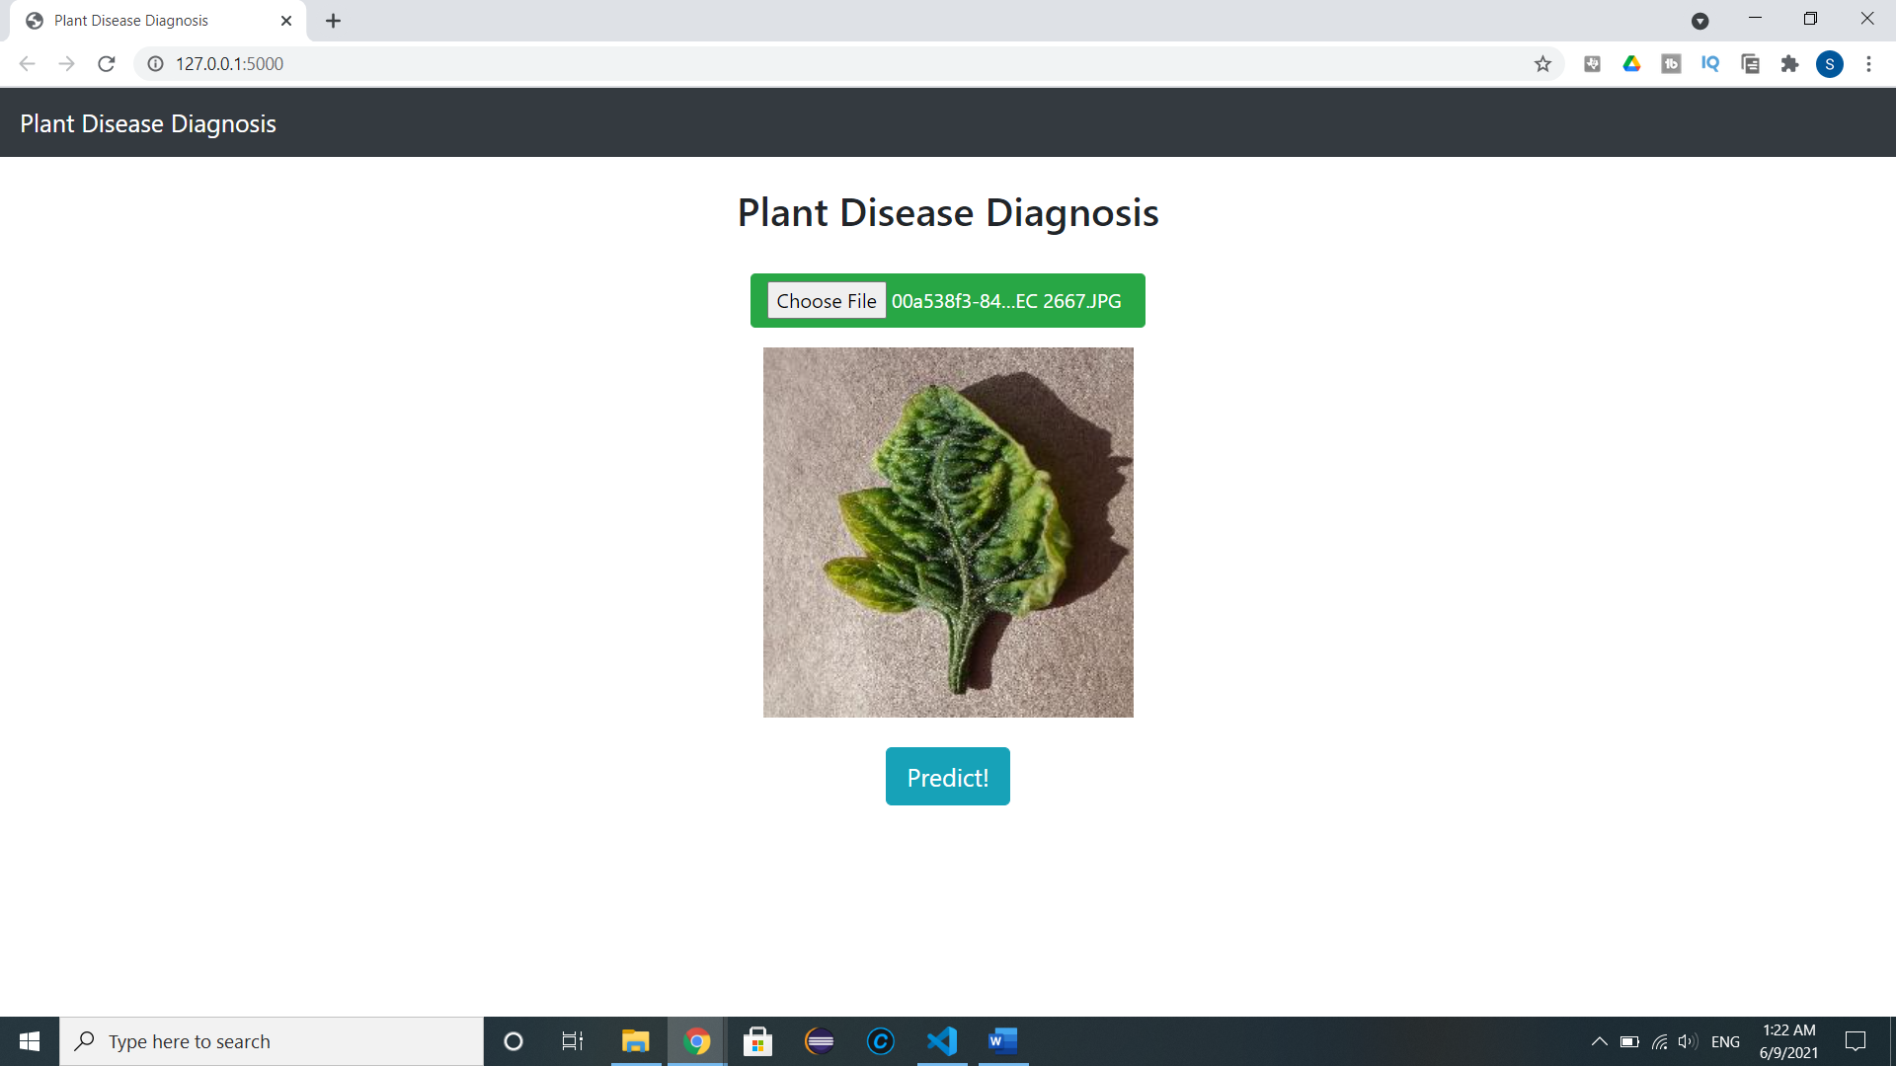

Slide 17
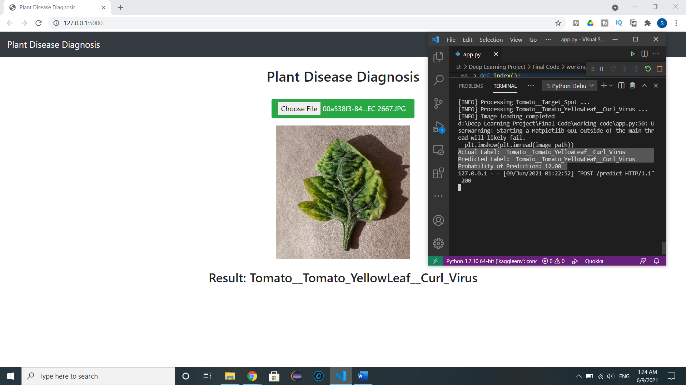

Slide 18
RESULTS AND OBSERVATIONS
The goal is to high accuracy with less computational resource
Made changes to improve the overall accuracy
Reduced the negative results and Observe the affect of outliers and weakly labelled input on the overall result
Increased the Epochs to avoid underfitting and improve performance(Accuracy)
Not affected due to lighting conditions when image is taken

Slide 19
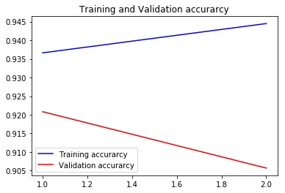
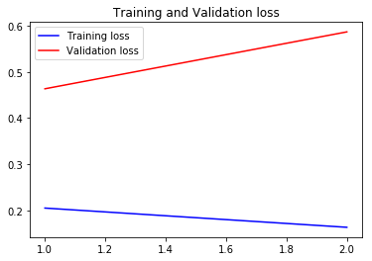
RESULT AFTER TRAINING(2 Epochs)
Trained the model for lesser iterations to obtain a sample result

Slide 20
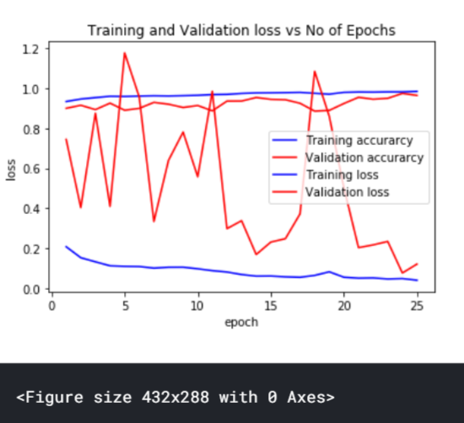
RESULT AFTER TRAINING(25 Epochs)
There are 20639 images available for training
Images shape = (2952, 256, 256, 3)
Labels shape = (2952,)
x_train shape = (2361, 256, 256, 3)
y_train shape = (2361, 15)
x_test shape = (591, 256, 256, 3)
y_test shape = (591, 15)

Slide 21
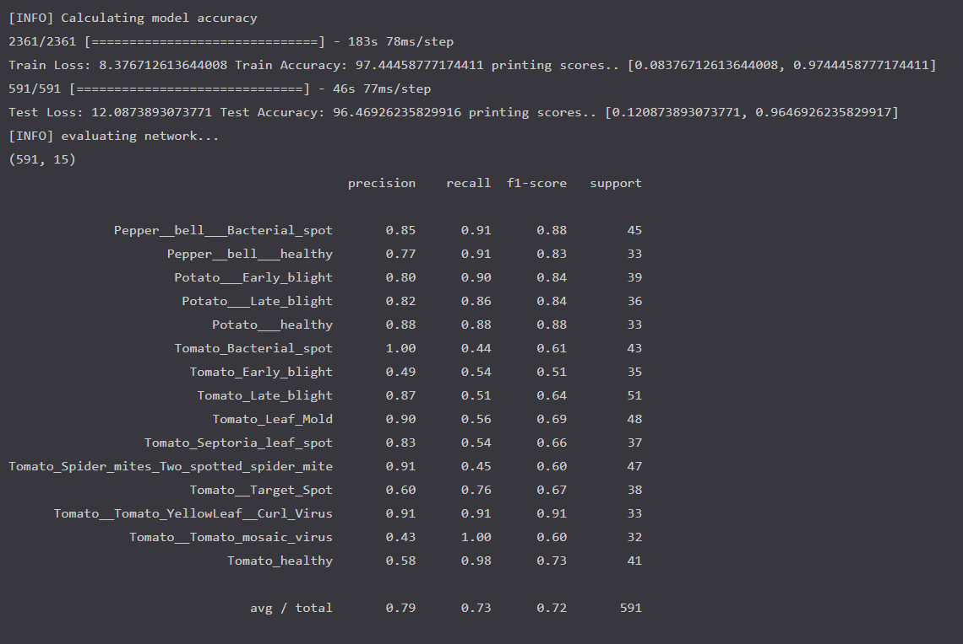

Slide 22
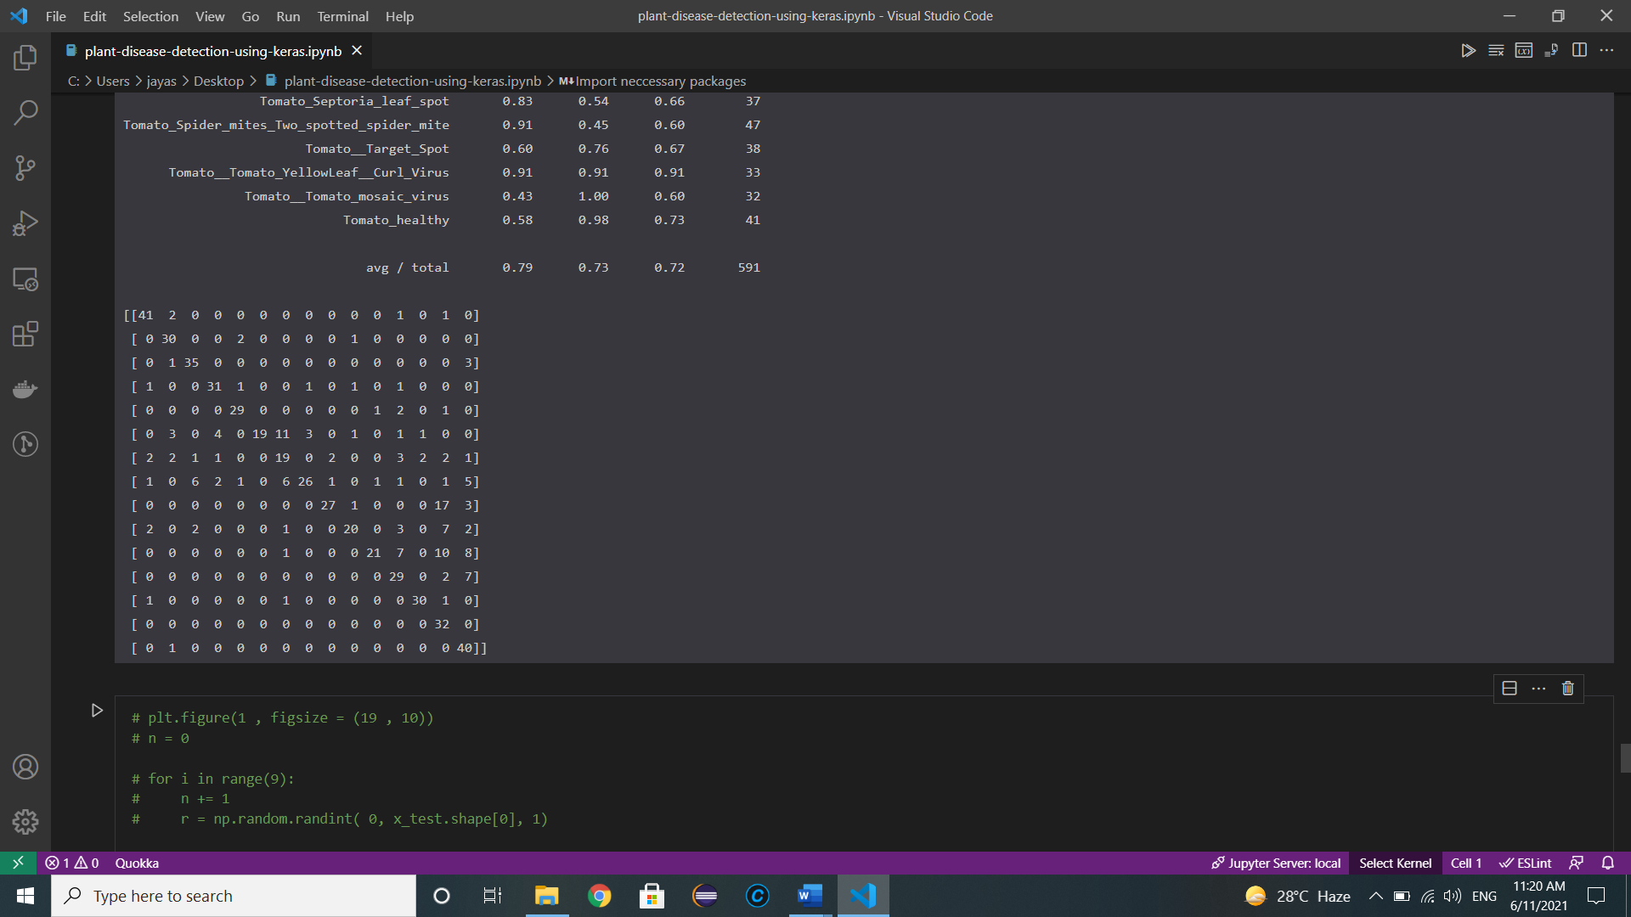
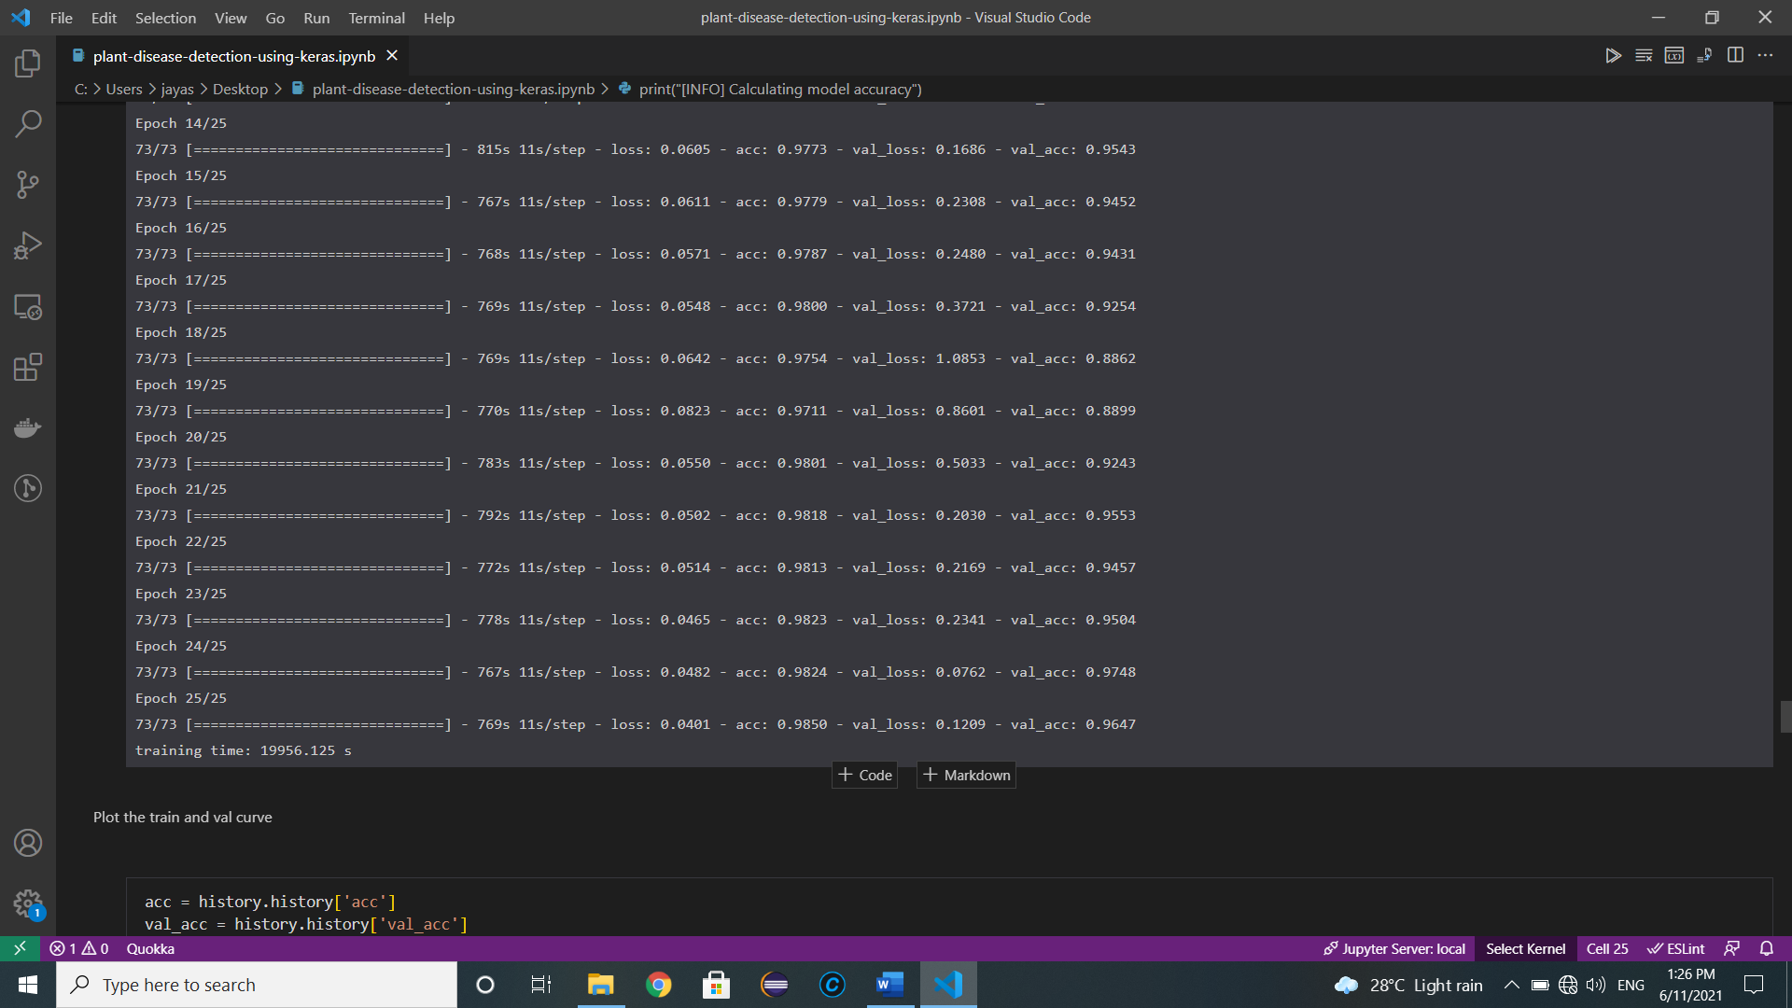

Slide 23
CONCLUSION AND FUTURE SCOPE
We can use existing CNN architectures (Alex Net and Google Net) to detect and classify plant diseases and integrate with our model to improve accuracy.(Known as Transfer Learning)
CNN models are not transparent. So can improve it by using Keras Tuner
Can find out about the affect on weakly labelled images on the outcome
Model Accuracy achieved is about 96%.
In the future it can contribute to smart agriculture techniques and help in early prevention.
Can be coupled with robotics and powerful FPGAs to be used in real-time application
We can further give solution to diseases by implementing a recommendation system

Slide 24
REFERENCES
https://www.irjet.net/archives/V7/i2/IRJET-V7I2539.pdf
https://www.aaai.org/ocs/index.php/FLAIRS/FLAIRS18/paper/viewFile/17682/16870
https://www.hindawi.com/journals/cin/2016/3289801/
Brahimi M, Boukhalfa K, Moussaoui A (2017) Deep Learning for Tomato Diseases: Classification and Symptoms Visualization
Dandawate Y, Kokare R (2015) An automated approach for classification of plant diseases towards development of futuristic Decision Support System in Indian perspective.
Wang K, Zhang D, Li Y, Zhang R, Lin L (2017) Cost-effective active learning for deep image classification.

